Slide 1
Embedded ‘C’ Programming 8051 MC Interfacing

Slide 2
Embedded ‘C’ Programming
Compilers produce hex files that is downloaded to ROM of microcontroller
The size of hex file is the main concern. Microcontrollers have limited on-chip ROM Code space for 8051 is limited to 64K bytes
Why Embedded ‘C’ Programming
It is easier and less time consuming to write in C than Assembly
C is easier to modify and update
You can use code available in function libraries
C code is portable to other microcontroller with little of no modification

Slide 3
A good understanding of C data types for 8051 can help programmers to create smaller hex files
Unsigned char
Signed char
Unsigned int
Signed int
Sbit (single bit)
Bit and sfr
The character data type is the most natural choice
8051 is an 8-bit microcontroller. Unsigned char is an 8-bit data type in the range of 0 – 255 (00 – FFH)
One of the most widely used data types for the 8051
Counter value
ASCII characters
C compilers use the signed char as the default if we do not put the keyword
unsigned

Slide 5
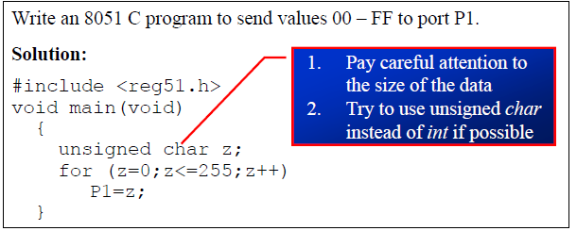
Examples

Slide 6
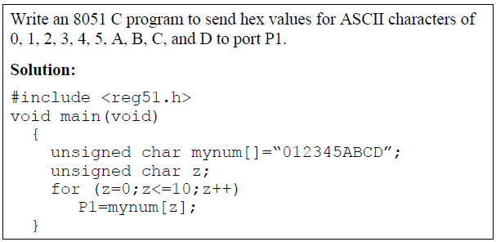
Examples

Slide 7
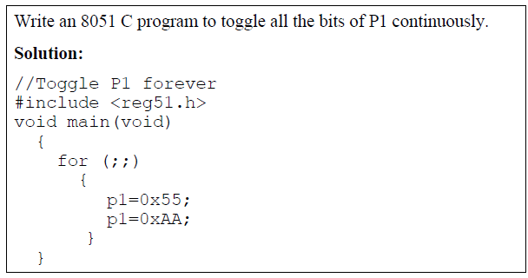
Examples

Slide 8
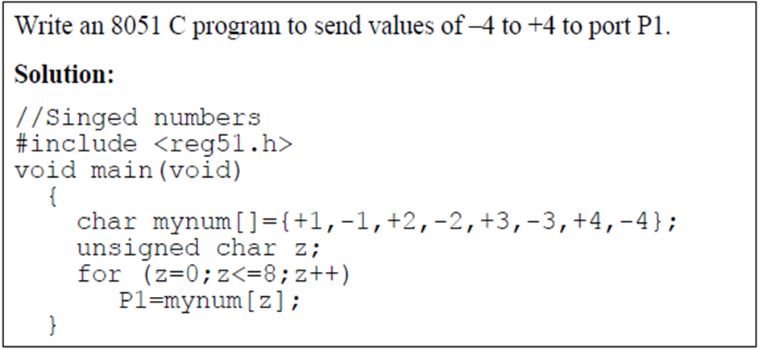

Slide 9
The unsigned int is a 16-bit data type
Takes a value in the range of 0 to 65535 (0000 – FFFFH)
Define 16-bit variables such as memory addresses.
Set counter values of more than 256
Since registers and memory accesses are in 8-bit chunks, the misuse of int variables will result in a larger hex file
Signed int is a 16-bit data type: Use the MSB D15 to represent – or +
We have 15 bits for the magnitude of the number from –32768 to +32767

Slide 10
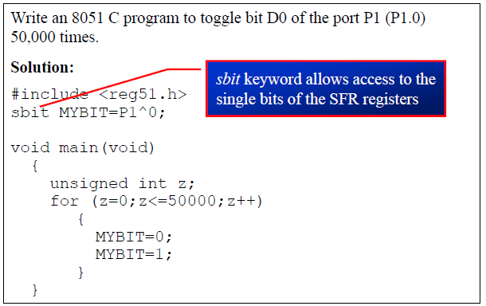

Slide 13
8051 Interfacing

Slide 14
Interfacing is a method, that provides communication between Microcontroller and the interface device.
An interface is either Input device, or output device, or a storage device, or processing device.
Input Interface Devices: Push button switch, Keypad, Infrared sensor, Temperature sensor, gas Sensor etc. These devices provide some information to the Microcontroller, and this is called as input data.
Output Interface Devices: LED, LCD, Buzzer, Relay driver, DC Motor Driver, 7-Segment Display etc.
Storage Interface Devices: Used to store/ retain the data, example, SD card, EEPROM, DataFlash, Real Time Clock, etc

Slide 15
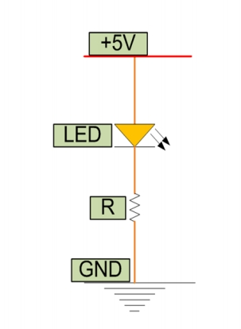
8051 Interfacing LED
LED (Light Emitting Diode) is a P N junction diode which emits light when activated.
•
It is activated when the PN junction sustains a forward voltage (forward bias), a current from P to N, called forward current. When this current is applied, electrons recombine with electron holes within the device thereby releasing energy in form of light.
•
•
LED finds application in traffic signals, lighting, camera flashes etc.
•
•
The way to distinguish between the positive and negative terminal is, the positive is longer than the negative in length.

Slide 16
Interfacing comprises of hardware (Interface device) and Software (source code to communicate, also called as the Driver).
Simply, to use an LED as the output device, LED should be connected to Microcontroller port and the MC has to be programmed inside make LED ON or OFF or blink or dim.
This program is called as the driver/firmware. The driver software can be developed using any programming language like Assembly, C etc.

Slide 17
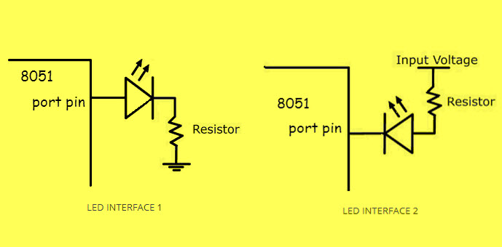
LED INTERFACE
The resistor is important in LED interfacing to limit the flowing current and avoid damaging the LED and/or MCU.
Interface 1 will glow LED, only if the PIN value of the MC is HIGH as current flows towards the ground.
Interface 2 will glow LED, only if the PIN value of the MC is LOW as current flows towards PIN due to its lower potential.

Slide 18
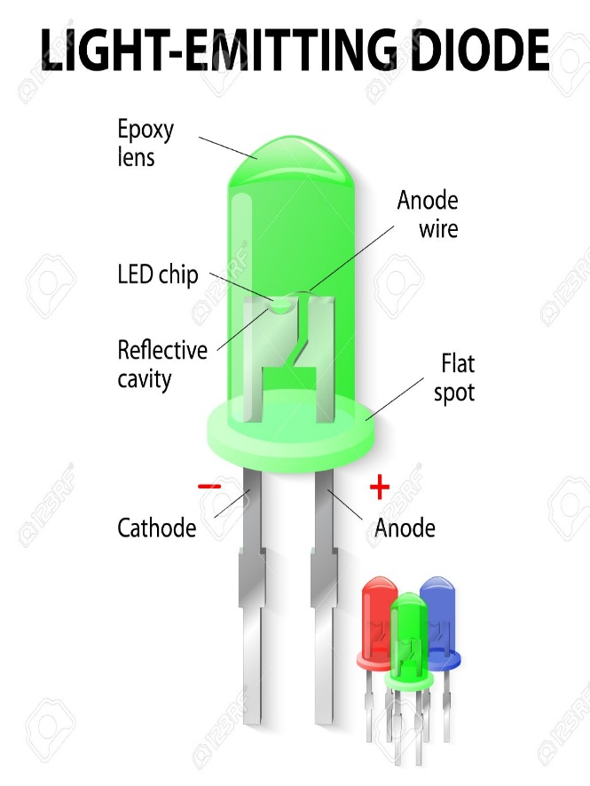
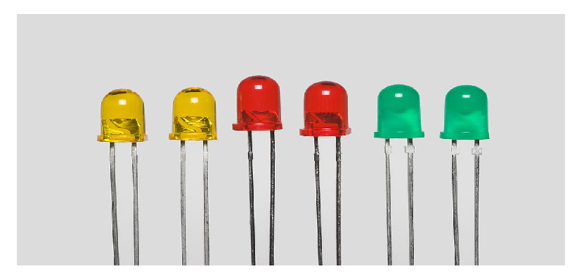
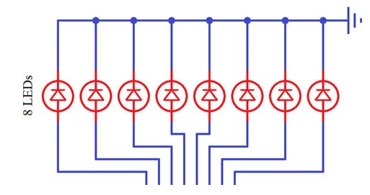
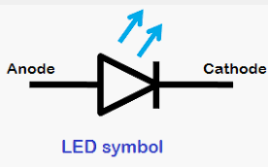
Interfacing Example (LED Interfacing))
Light Emitting Diode

Slide 19
8051 Interfacing LED
• In the following Diagram, LEDs are connected to the port P0.
• LEDs need approximately voltage drop of 1.7V and 10mA current to flow through them in order to glow at maximum intensity.

Slide 20
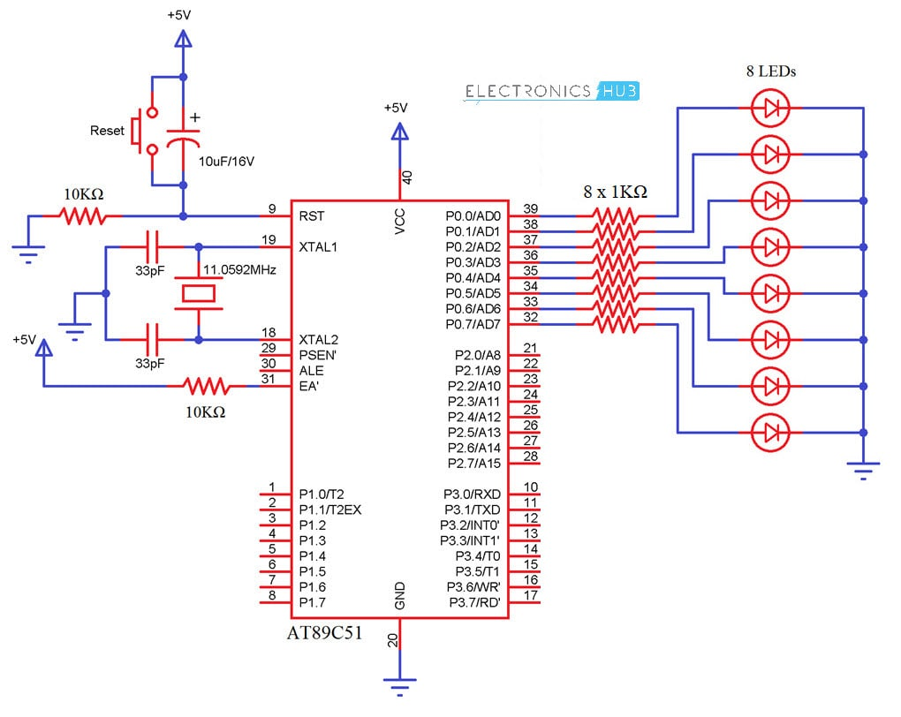

Slide 21
Program for LED Interfacing
# include<reg51.h>
void delay();
void main()
{
while(1)
{
P0=0X01;
delay();
P0=0X02;
delay();
P0=0X04;
delay();
P0=0X08;
delay();
P0=0X10;
delay();
P0=0X20;
delay();
P0=0X40;
delay();
P0=0X80;
delay();
}
}
void delay()
{
int i;
for(i=0;i<=30000;i++);
}

Slide 22
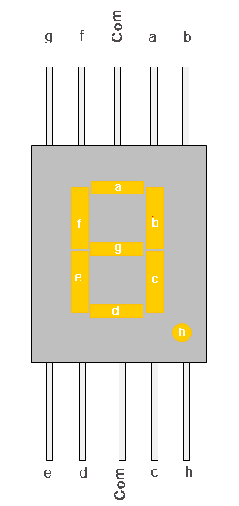
7 Segment Display
It’s the simplest unit to display numbers and characters.
It just consists 8 LEDs, each LED used to illuminate one segment of unit and the 8th LED used to illuminate DOT in 7 segment display.
We can refer each segment as a LINE, as we can see there are 7 lines in the unit, which are used to display a number/character.
We can refer each line/segment "a,b,c,d,e,f,g" and for dot character we will use "h".
There are 10 pins, in which 8 pins are used to refer a,b,c,d,e,f,g and h/dp, the two middle pins are common anode/cathode of all he LEDs.
These common anode/cathode are internally shorted so we need to connect only one COM pin.

Slide 23
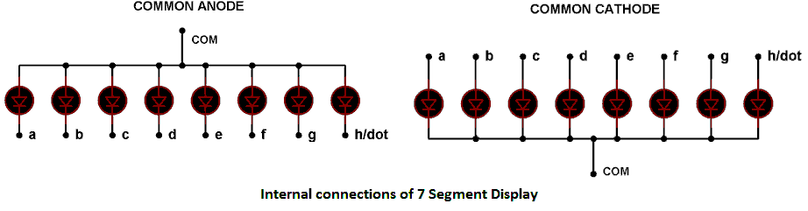
Common Anode: In this all the positive terminals (anode) of all the 8 LEDs are connected together (see diagram below), named as COM. And all the negative terminals are left alone.
Common Cathode: In this all the negative terminals (cathodes) of all the 8 LEDs are connected together, named as COM. And all the positive terminals are left alone.

Slide 24
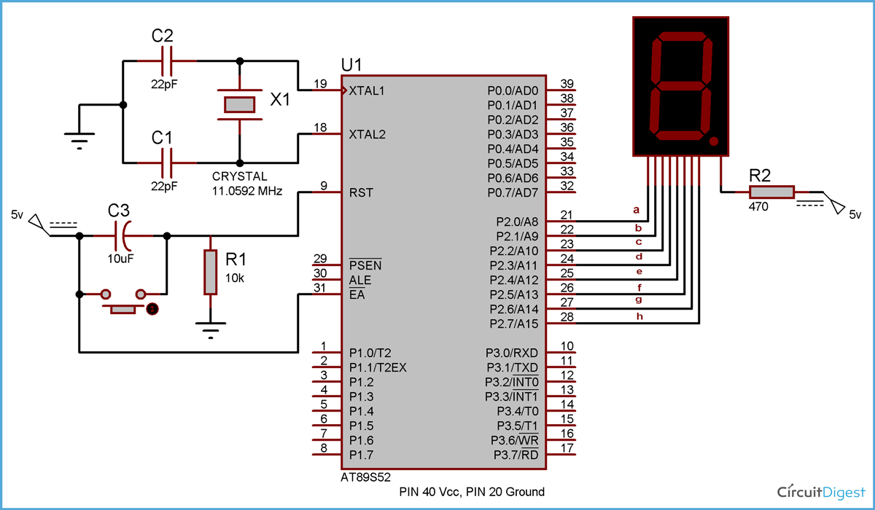
7 Segment Interfacing

Slide 25

COMMON ANODE MODE

Slide 26
COMMON ANODE MODE
Digit to display | hgfedcba | Hex Code
0 | 11000000 | C0
1 | 11111001 | F9
2 | 10100100 | A4
3 | 10110000 | B0
4 | 10011001 | 99
5 | 10010010 | 92
6 | 10000010 | 82
7 | 11111000 | F8
8 | 10000000 | 80
9 | 10010000 | 90
for common cathode mode complement each digit.

Slide 27
COMMON ANODE MODE
/ Code for 7 Segment Display Interfacing with 8051 Microcontroller (AT89S52)
#include<reg51.h>
void msdelay (unsigned int time) // Function for creating delay in milliseconds. { unsigned int i,j ; for(i=0;i<time;i++) for(j=0;j<1275;j++); }
void main() { unsigned char no_code[]={0xC0,0xF9,0xA4,0xB0,0x99,0x92,0x82,0xF8,0x80,0x90}; //Array for hex values (0-9) for common anode 7 segment unsigned int k; while(1) { for(k=0;k<10;k++) { P2=no_code[k]; msdelay(100); } } }
header
time delay (or duration for which each no. will be displayed)
??
Total 10 nos. to be displayed (0 to 9)
Eg., For k = 0, 0xC0 is selected hence ‘0’ is displayed
Eg. ‘0’ is displayed for 100ms

Slide 28
LCD Interfacing
LCD is finding widespread use replacing LEDs
The declining prices of LCD
The ability to display numbers, characters, and graphics
Incorporation of a refreshing controller into the LCD, thereby relieving the CPU of the task of refreshing the LCD.
Ease of programming for characters and graphics

Slide 29
Display units are the most important output devices in embedded projects and electronics products.
16x2 LCD is one of the most used display unit.
16x2 LCD means that there are two rows in which 16 characters can be displayed per line, and each character takes 5X7 or 5x8 matrix space on LCD.
Used to design embedded projects like digital voltmeter / ammeter, digital clock, home automation displays, status indicator display, digital code locks, digital speedometer/ odometer, display for music players etc.
It is available in a 16 pin package with back light ,contrast adjustment function and each dot matrix has 5×8 dot resolution.

Slide 30
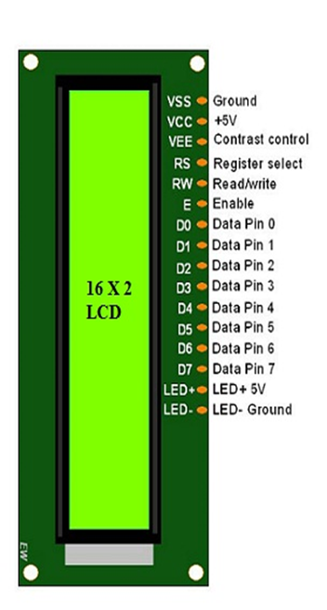
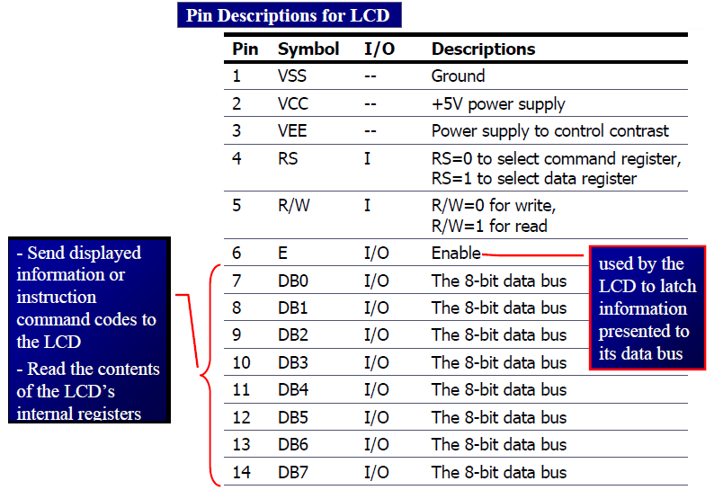

Slide 31
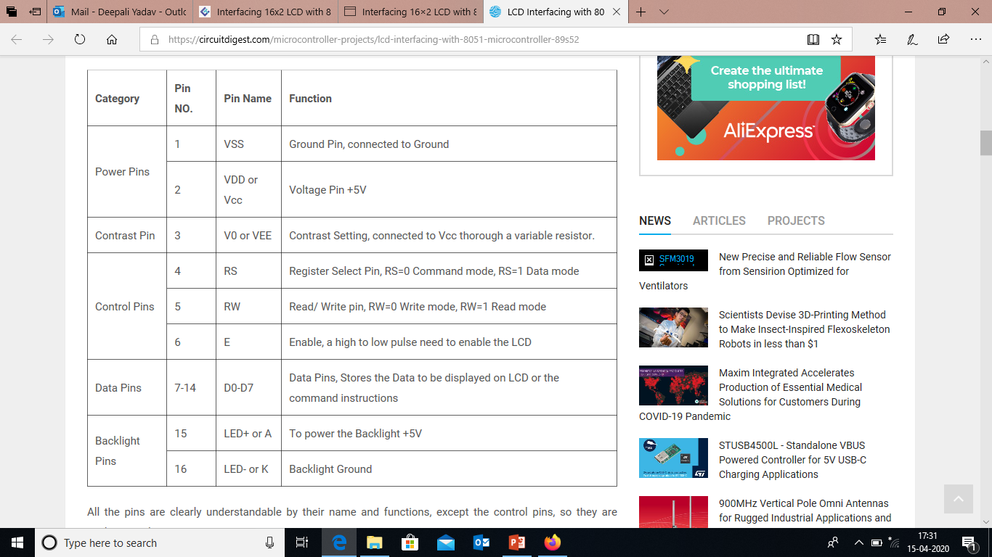
PIN DIVISION

Slide 32
VEE PIN
VEE pin is meant for adjusting the contrast of the LCD display and the contrast can be adjusted by varying the voltage at this pin.
This is done by connecting one end of a POT to the Vcc (5V), other end to the Ground and connecting the center terminal (wiper) of of the POT to the VEE pin..

Slide 33
DATA REGISTER & COMMAND REGISTER
It has two built in registers namely data register and command register.
Data register is for placing the data to be displayed , and the command register is to place the commands.
The 16×2 LCD module has a set of commands each meant for doing a particular job with the display.
High logic at the RS pin will select the data register and Low logic at the RS pin will select the command register.
If we make the RS pin high and the put a data in the 8 bit data line (DB0 to DB7) , the LCD module will recognize it as a data to be displayed .
If we make RS pin low and put a data on the data line, the module will recognize it as a command.

Slide 34
RS: RS is the register select pin. We need to set it to 1, if we are sending some data to be displayed on LCD. And we will set it to 0 if we are sending some command instruction like clear the screen (hex code 01).
RW: This is Read/write pin, we will set it to 0, if we are going to write some data on LCD. And set it to 1, if we are reading from LCD module. Generally this is set to 0, because we do not have need to read data from LCD. Only one instruction “Get LCD status”, need to be read some times.
E: This pin is used to enable the module when a high to low pulse is given to it. A pulse of 450 ns should be given. That transition from HIGH to LOW makes the module ENABLE.
DB0 to DB7 are the data pins. The data to be displayed and the command instructions are placed on these pins.
LED+ is the anode of the back light LED and this pin must be connected to Vcc through a suitable series current limiting resistor.
LED- is the cathode of the back light LED and this pin must be connected to ground.

Slide 35
LCD Command Codes
 | Code (Hex) Command to LCD Instruction Register
 | 1 Clear display screen
 | 2 Return home
 | 4 Decrement cursor (shift cursor to left)
 | 6 Increment cursor (shift cursor to right)
 | 5 Shift display right
 | 7 Shift display left
 | 8 Display off, cursor off
 | A Display off, cursor on
 | C Display on, cursor off
 | E Display on, cursor blinking
 | F Display on, cursor blinking
 | 10 Shift cursor position to left
 | 14 Shift cursor position to right
 | 18 Shift the entire display to the left
 | 1C Shift the entire display to the right
 | 80 Force cursor to beginning to 1st line
 | C0 Force cursor to beginning to 2nd line
 | 38 2 lines and 5x7 matrix

Slide 36
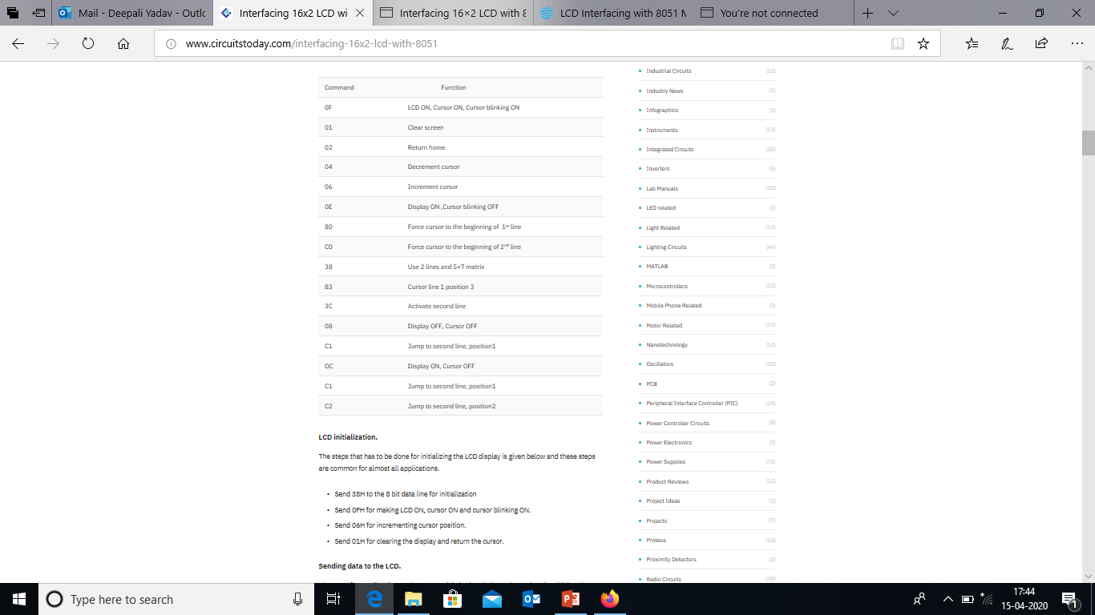

Slide 37
LCD initialization.
The steps that have to be done for initializing the LCD display is given below and these steps are common for almost all applications.
Send 38H to the 8 bit data line for initialization
Send 0FH for making LCD ON, cursor ON and cursor blinking ON.
Send 06H for incrementing cursor position.
Send 01H for clearing the display and return the cursor.

Slide 38
Sending data to the LCD.
The steps for sending data to the LCD module is given below.
LCD module has pins namely RS, R/W and E.
It is the logic state of these pins that make the module to determine whether a given data input is a command or data to be displayed.
Make R/W low.
Make RS=0 if data byte is a command and make RS=1 if the data byte is a data to be displayed.
Place data byte on the data register.
Pulse E from high to low.
Repeat above steps for sending another data.

Slide 39
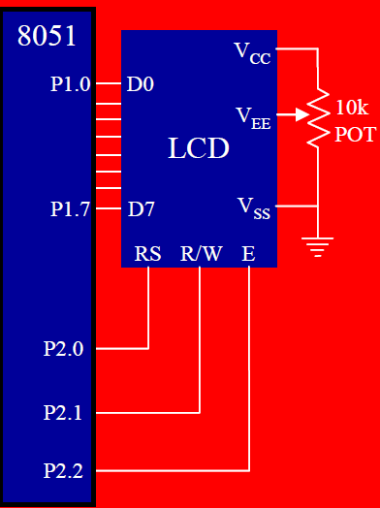
LCD Interfacing

Slide 40
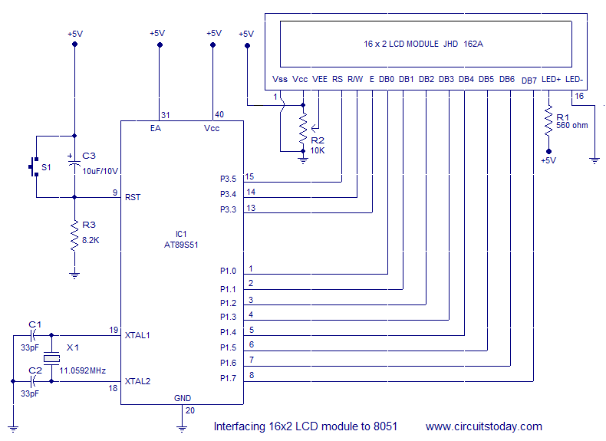
CIRCUIT DIAGRAM

Slide 41
The circuit diagram given shows how to interface a 16×2 LCD module with microcontroller.
Capacitor C3, resistor R3 and push button switch S1 forms the reset circuitry.
Ceramic capacitors C1,C2 and crystal X1 is related to the clock circuitry which produces the system clock frequency.
P1.0 to P1.7 pins of the microcontroller is connected to the DB0 to DB7 pins of the module respectively and through this route the data goes to the LCD module.
P3.3, P3.4 and P3.5 are connected to the E, R/W, RS pins of the microcontroller and through this route the control signals are transferred to the LCD module.
Resistor R1 limits the current through the back light LED and so do the back light intensity.
POT R2 is used for adjusting the contrast of the display(VEE).

Slide 42
1. LCD Interfacing Programming (Assembly)

Slide 43
LCD Interfacing Programming (Assembly)

Slide 44
2. LCD Interfacing Programming (Assembly) Busy Flag

Slide 45
LCD Interfacing Programming (Assembly) Busy Flag

Slide 46
LCD Interfacing Programming (Assembly) DPTR

Slide 47
LCD Interfacing Programming (Assembly) DPTR

Slide 48
Subroutine COMNWRT sets the logic of the RS, R/W, E pins of the LCD module so that the module recognizes the input data ( given to DB0 to DB7) as a command.
Subroutine DATAWRT sets the logic of the RS, R/W, E pins of the module so that the module recognizes the input data as a data to be displayed .

Slide 49
LCD Interfacing Programming (C)
Example
Write an 8051 C program to send letters ‘M’, ‘D’, and ‘E’ to the LCD using the busy flag method.
Solution:
#include <reg51.h>
sfr ldata = 0x90; //P1=LCD data pins sbit rs = P2^0;
sbit rw = P2^1;
sbit en = P2^2; sbit busy = P1^7; void main()
{
lcdcmd(0x38); lcdcmd(0x0E);
lcdcmd(0x01); lcdcmd(0x06);
lcdcmd(0x86); //line 1, position 6 lcddata(‘M');
lcddata(‘D');
lcddata(‘E');
}
.....

Slide 50
LCD Interfacing Programming (C)
.....
void lcdcmd(unsigned char value)
{
lcdready(); ldata = value; rs = 0;
rw = 0;
en = 1; MSDelay(1); en = 0; return;
//check the LCD busy flag
//put the value on the pins
//strobe the enable pin
}
void lcddata(unsigned char value)
{
lcdready(); ldata = value; rs = 1;
rw = 0;
en = 1; MSDelay(1); en = 0; return;
//check the LCD busy flag
//put the value on the pins
//strobe the enable pin
}
.....

Slide 51
LCD Interfacing Programming (C)
.....
void lcdready()
{
busy = 1;
rs = 0;
rw = 1; while(busy==1)
{
en = 0; MSDelay(1); en = 1;
}
//make the busy pin at input
//wait here for busy flag
//strobe the enable pin
void MSDelay ()(unsigned int itime)
{
unsigned int i, j; for(i=0;i<itime;i++)
for(j=0;j<1275;j++);
}

Slide 52
KEYBOARD Interfacing
Keyboards are organized in a matrix of rows and columns
The CPU accesses both rows and columns through ports
Therefore, with two 8-bit ports, an 8 x 8 matrix of keys can be connected to a microprocessor
When a key is pressed, a row and a column make a contact
Otherwise, there is no connection between rows and columns

Slide 53
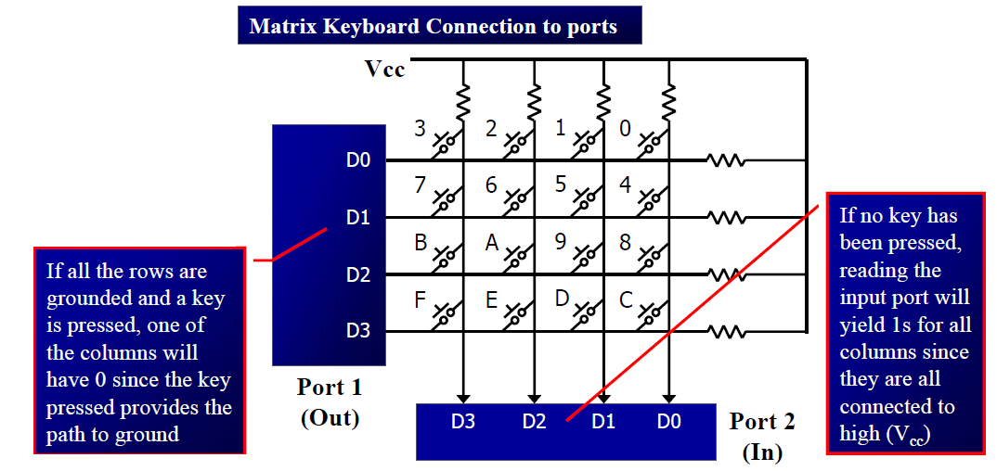
4 x 4 Matrix
A 4x4 matrix connected to two ports
The rows are connected to an output port and the columns are connected to an input port

Slide 54
It is the function of the microcontroller to scan the keyboard continuously to detect and identify the key pressed
To detect a pressed key, the microcontroller grounds all rows by providing 0 to the output latch, then it reads the columns
If the data read from columns is D3 – D0 = 1111, no key has been pressed and the process continues till key press is detected
If one of the column bits has a zero, this means that a key press has occurred
For example, if D3 – D0 = 1101, this means that a key in the D1 column has been pressed
After detecting a key press, microcontroller will go through the process of identifying the key

Slide 55
Starting with the top row, the microcontroller grounds it by providing
a low to row D0 only
It reads the columns, if the data read is all 1s, no key in that row is activated and the process is moved to the next row It grounds the next row, reads the columns, and checks for any zero
This process continues until the row is identified
After identification of the row in which the key has been pressed
Find out which column the pressed key belongs to

Slide 56
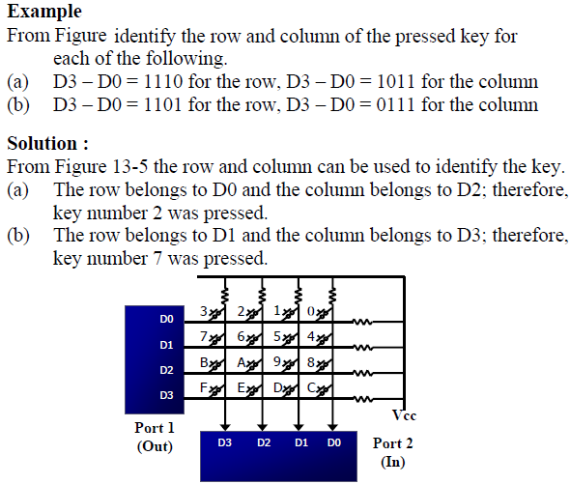

Slide 57
Program for detection and identification of key activation goes through the following stages:
1. To make sure that the preceding key has been released, 0s are output to all rows at once, and the columns are read and checked repeatedly until all the columns are high
When all columns are found to be high, the program waits for a short amount of time before it goes to the next stage of waiting for a key to be pressed
2. To see if any key is pressed, the columns are scanned over and over in an infinite loop until one of them has a 0 on it
Remember that the output latches connected to rows still have their initial zeros (provided in stage 1), making them grounded
After the key press detection, it waits 20 ms for the bounce and then scans the columns again
it ensures that the first key press detection was not an erroneous one due a spike noise
the key press. If after the 20-ms delay the key is still pressed, it goes back into the loop to detect a real key press

Slide 58
Mechanical switches are used as keys in most of the keyboards. When a key is pressed the contact bounce back and forth and settle down only after a small time delay (about 20ms). Even though a key is actuated once, it will appear to have been actuated several times. This problem is called Key Bouncing.
To detect which row key press belongs to, it grounds one row at a time, reading the columns each time
If it finds that all columns are high, this means that the key press cannot belong to that row
Therefore, it grounds the next row and continues until it finds the row the key press belongs to
Upon finding the row that the key press belongs to, it sets up the starting address for the look-up table holding the scan codes (or ASCII) for that row
To identify the key press, it rotates the column bits, one bit at a time, into the carry flag and checks to see if it is low
Upon finding the zero, it pulls out the ASCII code for that key from the look-up table
otherwise, it increments the pointer to point to the next element of the look-up table

Slide 59
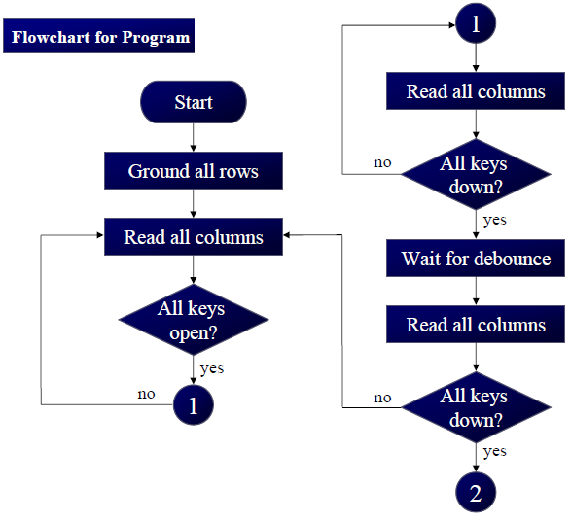
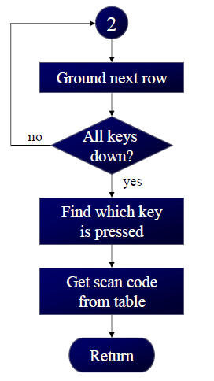
Flow Chart

Slide 60
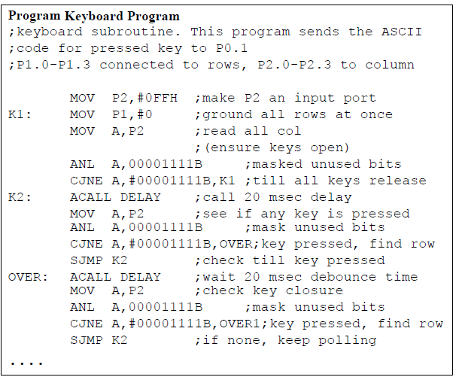

Slide 61
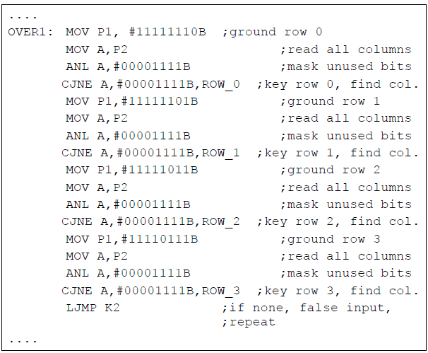

Slide 62
